Slide 1
GraphQL Subscriptions
a 10 slide lecture

Slide 2
GraphQL recap
query language + query execution engine === a different communication pattern
Type system
Schemas - definition / evolution / validates support
Operations
Query / Mutation / Subscription
Flexible data model
Decouples client from server
Client controls what it receives (selection set)
No more OverFetching, UnderFetching

Slide 3
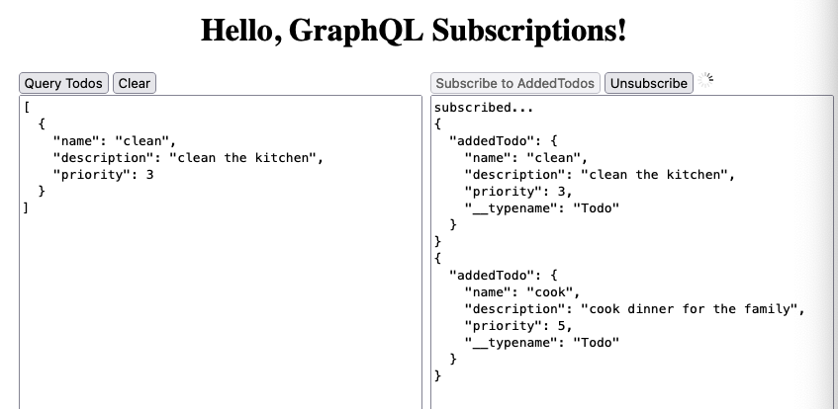
Demo

Slide 4
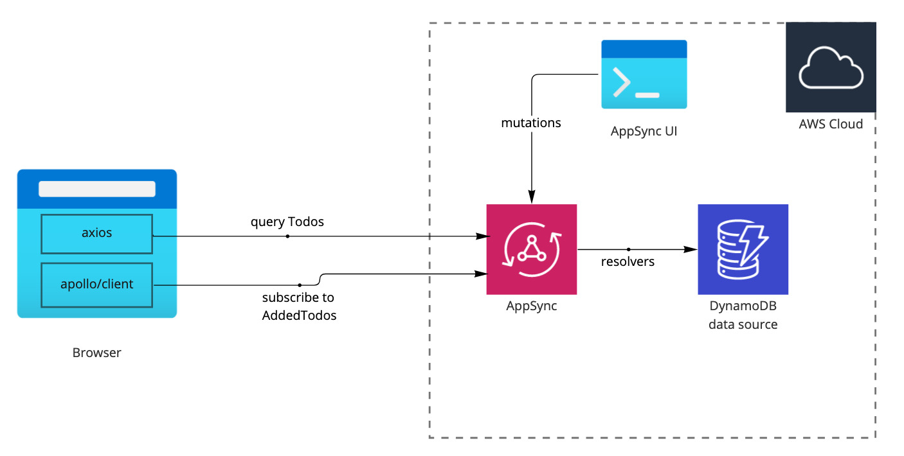
Architecture + Deployment

Slide 5
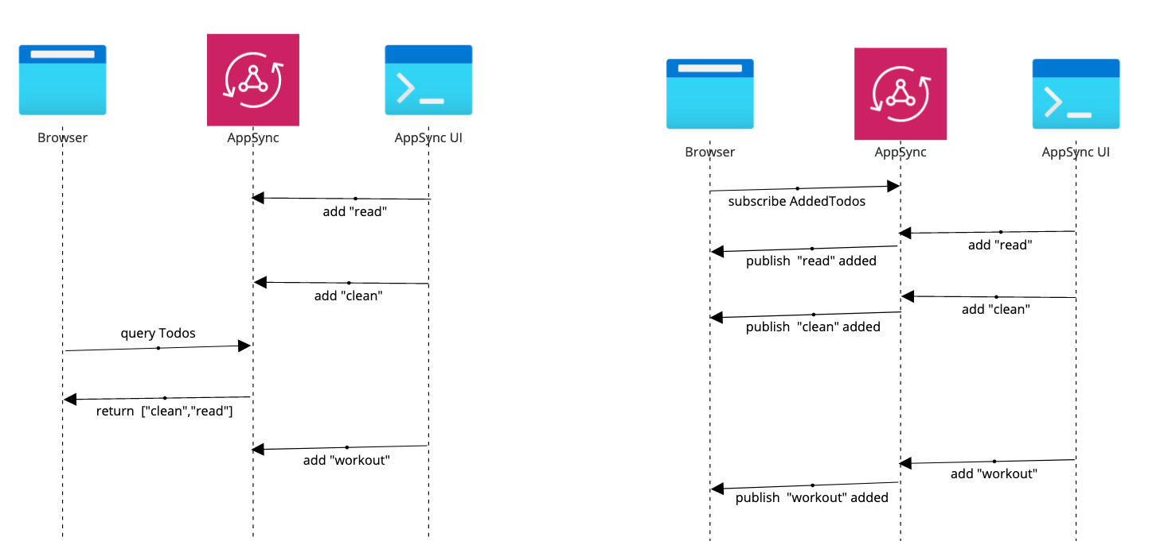
Sequence diagrams

Slide 6
Queries/Mutations | Subscriptions
request/response paradigm client requests something server responds something | publish/subscribe paradigm client subscribes to events triggers/events happen on server server sends updates to client (event stream)
stateless communication requests are independent connection opened on request,closed after response | stateful communication connection opened on subscribe long-living, continuous connection on client & server
pull-based data fetching - client pulls | push-based data fetching - server pushes
HTTP protocol | Websockets protocol MQTT protocol
+ no continuous connection, less resource consumption - slower updates | + faster updates - connections consumes more server/client resources - complex code (streams, observables, async iterators)

Slide 7
Implementations
Server
Graphql.js - reference implementation in Node.js
Express Graphql - reference implementation in Node.js over Express server
Apollo Server - server packages that work with various Node.js frameworks
AppSync - AWS offering, fully-managed GraphQL server
Client
Apollo Client - js client works with React, React Native, Angular 2
AWS Amplify - js library, used with cloud services, GraphQL backend and React components
GraphQL Request - a lightweight wrapper around fetch
Relay - js framework for building data-driven React applications

Slide 8
AppSync - Server Side
Make a subscription real-time by adding @aws_subscribe
AppSync subscriptions limitations
invoked as a response to a mutation
the mutation selection set is sent to subscribers
type Subscription { addedTodo: Todo @aws_subscribe(mutations: ["addTodo"]) }

Slide 9
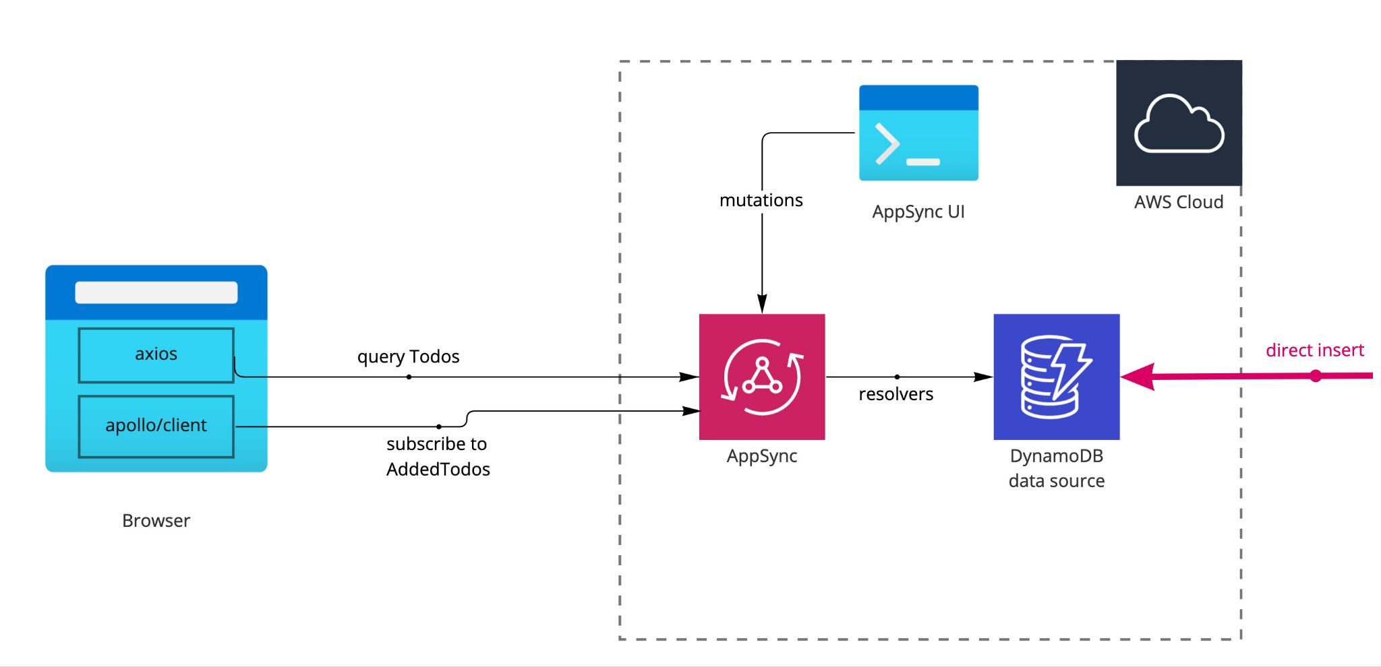
Demo - Limitations

Slide 10
Apollo - Client side
Filtering based on client-defined arguments
subscription query without filter arguments subscription with filter arguments
`subscription NewSubscription {
addedTodo {
name
description
priority
}
}`
`subscription NewFilteredSubscription($priority: Int) {
addedTodo(priority: $priority) {
name
description
priority
}
}`
apolloClient.subscribe({
query: SUBSCRIPTION_QUERY,
}).subscribe({ next(data) {},
error(error) {},
complete() {},
})
apolloClient.subscribe({
query: SUBSCRIPTION_QUERY,
variables: { "priority" : 1 }
}).subscribe({ next(data) {},
error(error) {},
complete() {},
})

Slide 11
Demo - Subscription Event Filtering

